Slide 1

CSCI 4502/5502
Data Mining - Fall 2023 - Lecture 16
Ravi Starzl, PhD

Slide 2
1
Chap 1: Introduction
2
Chap 2: Getting to know your data
Midterm Review
3
Chap 3: Data Preprocessing
4
Chap 4 & 5: Data Warehouse, Data Cube
5
Chap 6 & 7: Frequent Pattern Mining
6
Chap 8 & 9: Classification
Ravi Starzl, PhD - Data Mining Fall 2023

Slide 3

Chapter 1: Introduction
Why data mining?
data explosion (generation & sharing)
data rich but information poor
Data mining (knowledge discovery from data)
automated analysis of massive data
quality vs. efficiency
interesting patterns: valid, novel, potentially useful, ultimately understandable by human
Ravi Starzl, PhD - Data Mining Fall 2023

Slide 4

Data Mining: Various Views
Data view
kinds of data to be mined
Knowledge view
kinds of knowledge to be discovered
Method view
kinds of techniques utilized
Application view
kinds of applications adapted
Ravi Starzl, PhD - Data Mining Fall 2023

Slide 5

Chapter 2: Getting to Know Your Data
Data objects and attribute types
nominal, binary, ordinal, numeric
interval-scaled, ratio scaled
discrete vs. continuous
Measuring data similarity and dissimilarity
data matrix vs. dissimilarity matrix
proximity measures for nominal, binary, ordinal, numeric attributes
Ravi Starzl, PhD - Data Mining Fall 2023

Slide 6

Descriptive Summarization
Basics: N, min, max
Central tendency
mean, median, mode, midrange
Dispersion
quartiles, IQR, five number summary
variance, standard deviation
Graphic displays: box plot, histogram, quantile plot, quantile-quantile plot, scatter plot
Ravi Starzl, PhD - Data Mining Fall 2023

Slide 7

Chapter 3: Data Preprocessing
Why preprocessing data?
Data cleaning
Data integration
Data reduction
Data transformation and discretization
Ravi Starzl, PhD - Data Mining Fall 2023

Slide 8

Why Preprocessing Data?
Imperfect data
incomplete: missing attributes, values
noisy: errors, outliers
inconsistent: discrepancies
Measure of data quality
accuracy, completeness, consistency, timeliness, believability, value added, interpretability, accessibility
Ravi Starzl, PhD - Data Mining Fall 2023

Slide 9

Data Cleaning
Missing data
ignore, manual
automatic: constant, attribute mean, class attribute mean, most probable
Noisy data
binning: bin mean, median, boundary
regression
clustering
Ravi Starzl, PhD - Data Mining Fall 2023

Slide 10
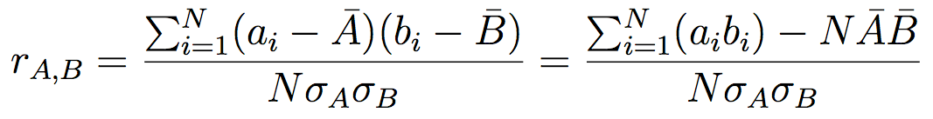
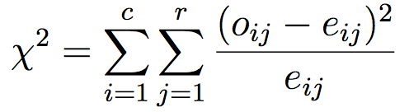
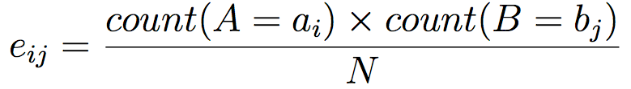
Correlation Analysis
Correlation coefficient (numerical data)
X2 (chi-square) test (categorical data)
Correlation does not imply causality!
Ravi Starzl, PhD - Data Mining Fall 2023

Slide 11

Data Reduction
Data reduction: Why? Goal?
Dimensionality reduction
attribute subset selection; Wavelet transform; principle component analysis (PCA)
Numerosity reduction
regression, log-linear models
data cube aggregation
histograms, clustering, sampling
Ravi Starzl, PhD - Data Mining Fall 2023

Slide 12

Data Transformation
Smoothing: remove noise from data
Aggregation: summarization
e.g., daily sales => monthly, annual sales
Generalization: concept hierarchy climbing
e.g., street => city => state
Normalization: scale to fall within a range
min-max, z-score, decimal scaling
Ravi Starzl, PhD - Data Mining Fall 2023

Slide 13

Chapter 4: Data Warehouse
Separate data store for information processing
Characteristics
subject-oriented
integrated
time-variant
nonvolatile
OLTP vs. OLAP
day to day operation
vs. decision support
Ravi Starzl, PhD - Data Mining Fall 2023

Slide 14

Chapter 4 & 5: Data Cube
Multi-dimensional data model
Dimensions, facts
Schema: star, snowflake, fact constellation
Typical operations
roll-up, drill-down, slice and dice, pivot, drillacross, drill-through
Cuboid cells, materialization of data cube
full, partial, or no materialization
Ravi Starzl, PhD - Data Mining Fall 2023

Slide 15

Chapters 6 & 7: Frequent Pattern Mining
Basic concepts, roadmap
Mining frequent itemsets
Mining association rules
Correlation analysis
Constraint-based association mining
Ravi Starzl, PhD - Data Mining Fall 2023

Slide 16

Mining Frequent Itemsets
Apriori algorithm
k-itemsets, candidate (k+1)-itemsets
Challenges
#scans, #candidates, support counting
Partition, sampling, dynamic itemset counting, hash-tree
FP-growth: FP-tree, conditional pattern base, conditional FP-tree
Vertical data format
Ravi Starzl, PhD - Data Mining Fall 2023

Slide 17
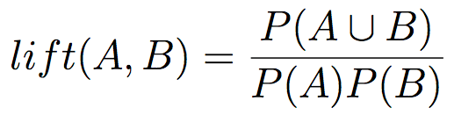
Associations & Correlations
Association: Support & confidence
Correlation rule
A ⇒ B [support, confidence, correlation]
lift, x^2, null-invariant
Ravi Starzl, PhD - Data Mining Fall 2023

Slide 18

Rule (Pattern) Constraints
Metarule
Anti-monotonicity
Monotonicity
Succinctness
Convertible constraints
with proper ordering of items
Strongly convertible
Inconvertible
Ravi Starzl, PhD - Data Mining Fall 2023

Slide 19

Chapter 8: Classification
Basic concepts
Decision tree induction
Bayesian classification
Rule-based classification
Model evaluation and selection
Improve classification accuracy
Summary
Ravi Starzl, PhD - Data Mining Fall 2023

Slide 20
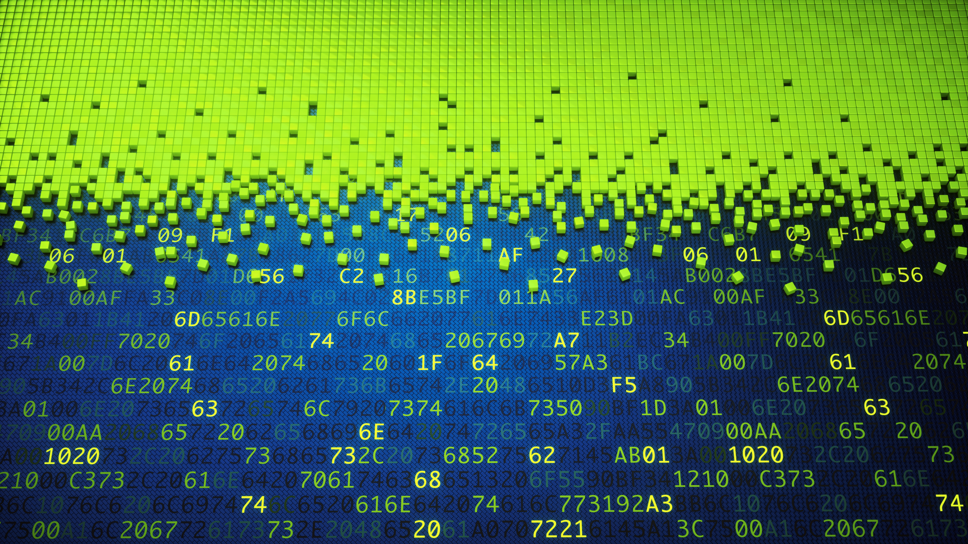
Classification vs. Prediction
Classification: categorical class labels
Prediction: continuous valued functions
Training vs. testing
Supervised vs. unsupervised
Evaluation criteria
accuracy, speed, robustness, scalability, interpretability, goodness of rules
Ravi Starzl, PhD - Data Mining Fall 2023

Slide 21

Decision Tree Induction
Top-down, recursive, divide-and-conquer
Attribute selection
information gain
gain ratio
gini index
Attribute split
discrete, continuous, discrete-binary
Ravi Starzl, PhD - Data Mining Fall 2023

Slide 22
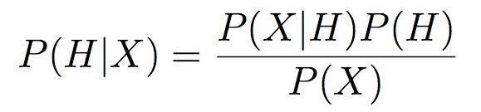
Bayesian Classification
Bayes’ Theorem
Naive Bayesian classifier
Ravi Starzl, PhD - Data Mining Fall 2023

Slide 23

Classifier Accuracy Measures
Accuracy, error rate
Confusion matrix
Costs and benefits of TP, TN, FP, FN
Sensitivity, specificity, precision
Predictor error measures
error, square error
absolute, mean, relative
Ravi Starzl, PhD - Data Mining Fall 2023

Slide 24

Classifier/ Predictor Evaluation
Holdout, random sampling
Cross-validation
k-fold stratified cross validation
Bootstrapping
sample with replacement
.632 bootstrap
Model selection
t-test, ROC curves
Ravi Starzl, PhD - Data Mining Fall 2023

Slide 25

Ensemble
Ensemble
combination of multiple models
bagging: majority vote (equal weight)
boosting (e.g., Adaboost): weighted
Ravi Starzl, PhD - Data Mining Fall 2023

Slide 26

Chapter 9: Advanced Classification
Bayesian belief networks
Backpropagation
Support vector machines
Lazy learning
Other classification methods
Additional topics regarding classification
Summary
Ravi Starzl, PhD - Data Mining Fall 2023

Slide 27

Chapter 10: Cluster Analysis
Basic concepts
Partitioning methods
Hierarchical methods
Density-based methods
Grid-based methods
Evaluation of clustering
Summary
Ravi Starzl, PhD - Data Mining Fall 2023

Slide 28

Cluster Analysis
Unsupervised learning
Intra/inter-cluster similarity
Requirements
scalability, various data types, arbitrary shape, minimal domain knowledge, noisy data, incremental, high dimensionality, constraint-based, interpretability
Ravi Starzl, PhD - Data Mining Fall 2023

Slide 29

Clustering Methods
Partitioning methods
k-means, k-medoids
Hierarchical methods
agglomerative, decisive
BIRCH, CHAMELEON
Density-based methods
DBSCAN, DENCLUE
Grid-based methods
STING, CLIQUE
Ravi Starzl, PhD - Data Mining Fall 2023

Slide 30
Review Chapters 1 through 9 - anything in those chapters is fair game
Chapter 10: Clustering.
Only general concepts from clustering will be asked - no formulas or equations. What are the basic concepts of clustering, what principles do they use (e.g. association by proximity), etc.
Some multiple choice questions
Some "Find the problem here" or "Write the missing code" type questions with simple python code (pseudocode acceptable if you don't know python well).
Some "Explain in your own words" type questions
Summary
Ravi Starzl, PhD - Data Mining Fall 2023

Slide 31
Thank you
A special thank you to Qin Lv for her slides, on which this lecture is based
Ravi Starzl, PhD - Data Mining Fall 2023

